Slide 1
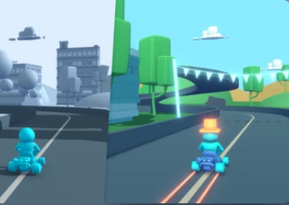
Self-Driving Kart
Guided by :
Prof. Pantaleon, Ivan
CIS -5850
Team -1

Slide 2


Team Members
Heta Parekh
Priya Ramdas
Pradnya Patil
Pooja Madhup

Slide 3
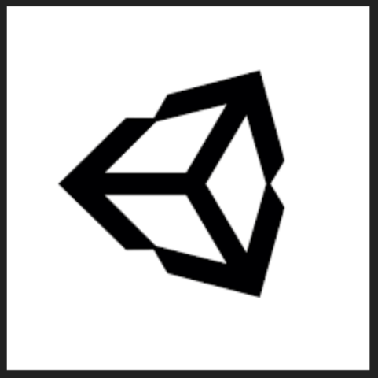

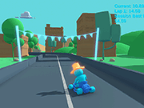
Introduction
Problem Statement
Simulate an autonomous vehicle environment with a virtual agent to navigate in a self-driving kart mode using Machine Learning
Platform and Tools
We used the Unity Engine and Unity Hub to render the simulation. We chose Unity for its platform support and easier usability.
We used Python programming language to integrate the Machine Learning model.
Presentation overview
We will discuss about the project process flow, solution process flow, Prototype and business application.

Slide 4
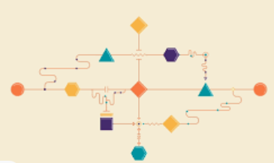
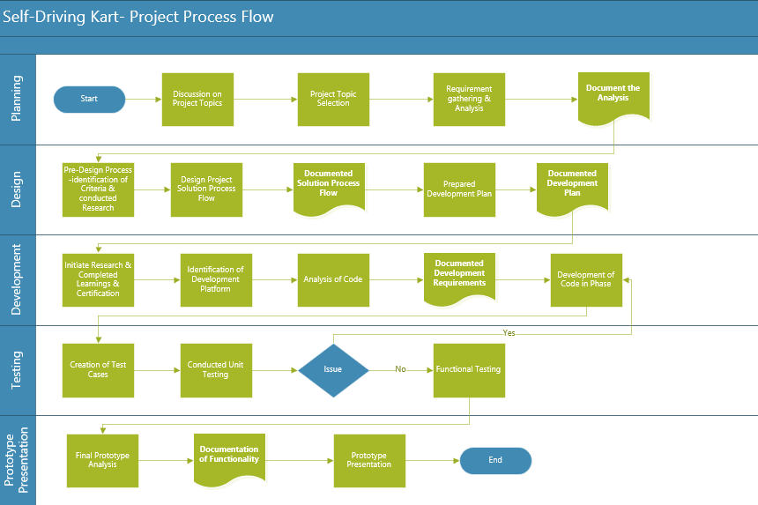
Project Process Flow

Slide 5
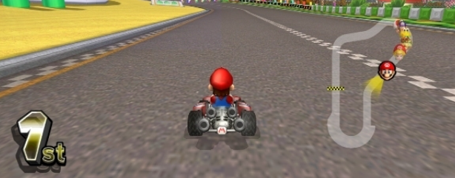

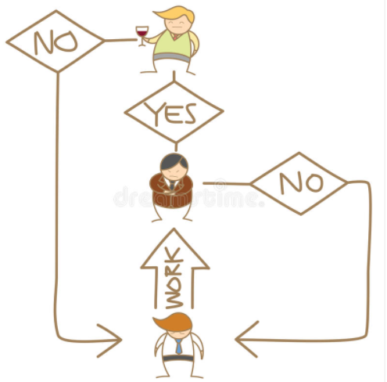
Solution Process Flow
Create minimum viable prototype
Created prototype
Identification of product code development platform
Prototyping
Product Definition
Ideation
Analysis of prototype design ideas
Created prototype design plan
Documentation of solution process flow
Define the core functionality
Created functional cases
Detailed
Design
Refinement of prototype
Detailed Product Design
Design Complete
Validation
& Testing
Ensuring prototype works as per plan
Validation of functionality and functional testing
Feature Complete

Slide 6
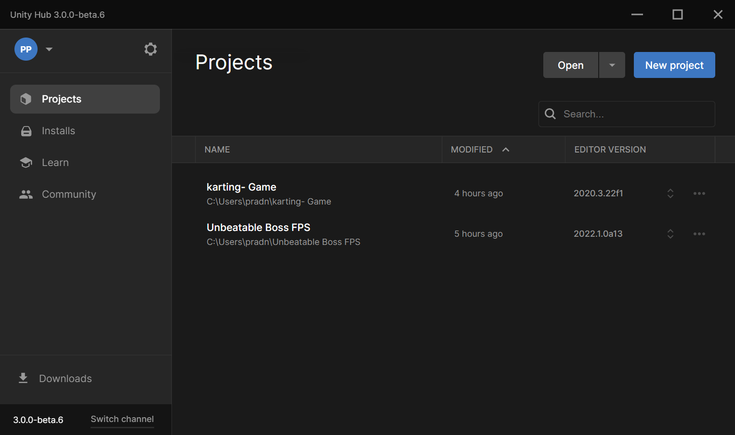
Prototype Design:
Platform : Unity Hub 3.0.0
The self-driving game is time trial game

Slide 7
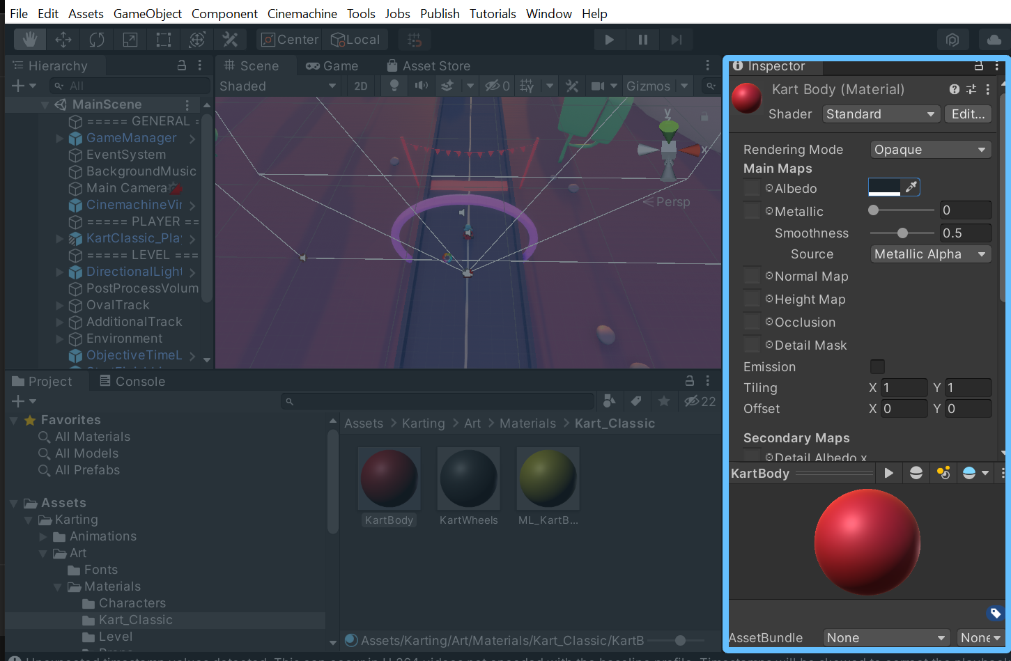
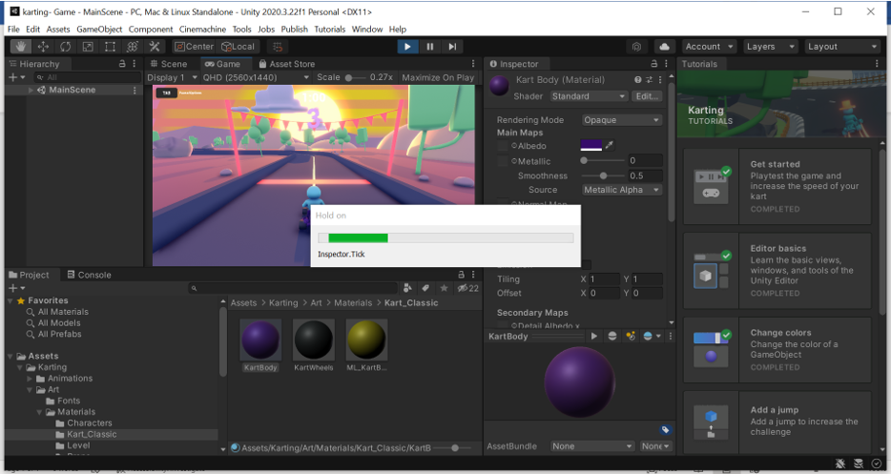
Color Feature:

Slide 8
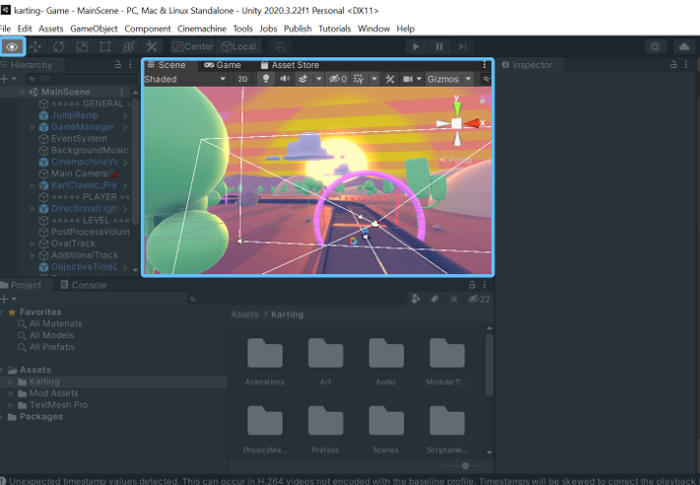
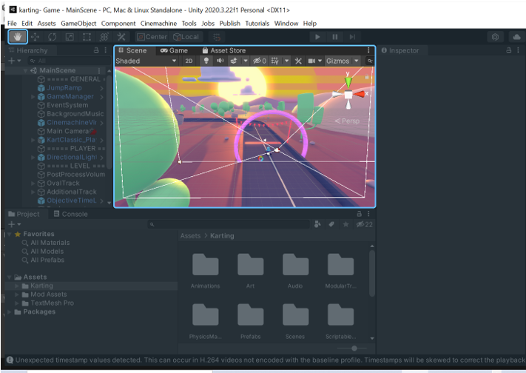
Track Design :

Slide 9
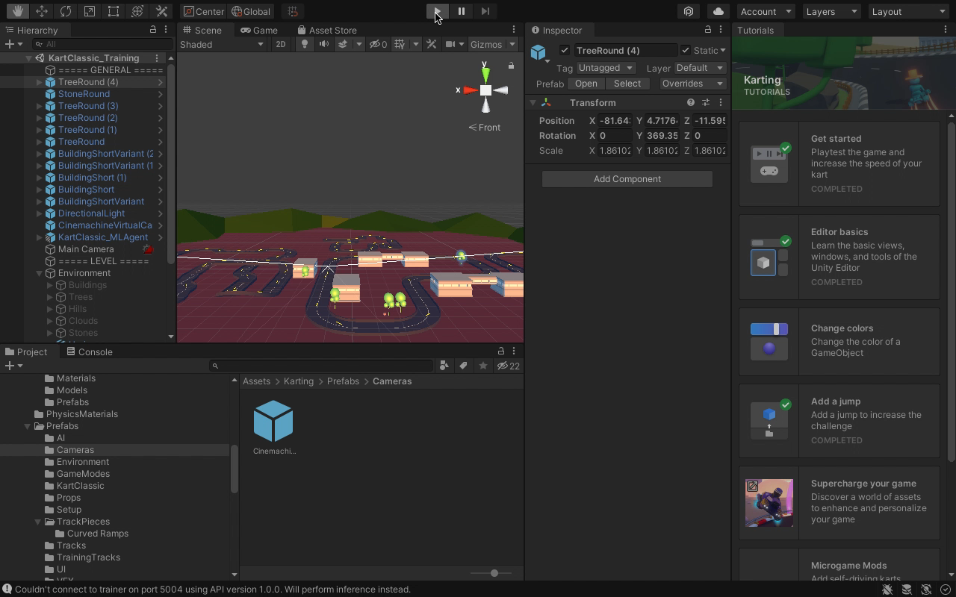
Smart Driving Kart :

Slide 10
Business Application:
Unity tool can be used to build the:
video games,
Animation projects and
developing a prototype.
In the real world this tool is being used to create the prototypes of self-driving cars.
BMW Uses Unity 3D to Create Virtual World for Autonomous Driving Development.

Slide 11
Conclusion
To conclude we have tried to create the prototype for the autopilot mode and going forward we can add more real-time seniors to get better results.

Slide 12


